Slide 1
A Distributed Algorithm to Compute Max-Min Fair Rates Without Per-Flow State
Lavanya Jose, Stephen Ibanez, Nick McKeown
Stanford University
Mohammad Alizadeh
MIT CSAIL

Slide 2
Imagine you’re a cloud provider..
You want
Fair + High Throughput Rates for Long Flows
Low Latency for Short Flows
Many attempts to achieve this, but they all have the same problem—they react to congestion instead of preventing it.
Notes:
Imagine you’re a cloud provider
-- fair, high throughput rates for your long flows
-- and low latency for short flows
There have been many attempts to achieve this, starting with TCP, but they all have the same problem today: they react to congestion instead of preventing it in the first place, because of this they can take a long time to converge relative to the flow sizes.

Slide 3
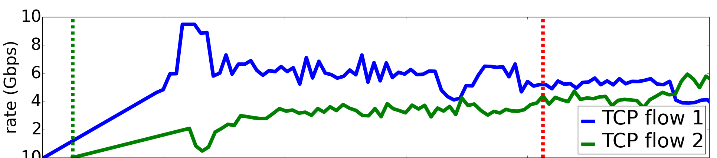


TCP takes 400 round trips for 2 flows!
10
8
6
4
2
0
rate (Gb/s)
0 100 200 300 400 500
time (RTTs)
10 Gb/s links
0.2 ms RTT
Notes:
This is TCP in a simple experiment. Two servers send a flow to a third server, and the bottleneck link is 10 Gb/s. Here I am plotting the rate of the two flwos over time. TCP takes 400 RTTs to reach their fair shares.
You might think recent algorithms are better. Here’s DCTCP, it doesn’t do much better either, taking 250 RTTs.
Today, I’m going to show you something like this.

Slide 4
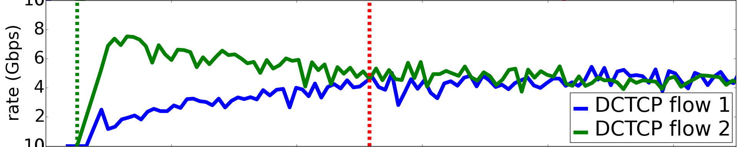
DCTCP takes 250 round trips for 2 flows!
10
8
6
4
2
0
rate (Gb/s)
0 100 200 300 400 500
time (RTTs)
10 Gb/s links
0.2 ms RTT
Notes:
This is TCP in a simple experiment. Two servers send a flow to a third server, and the bottleneck link is 10 Gb/s. Here I am plotting the rate of the two flwos over time. TCP takes 400 RTTs to reach their fair shares.
You might think recent algorithms are better. Here’s DCTCP, it doesn’t do much better either, taking 250 RTTs.
Today, I’m going to show you something like this.

Slide 5
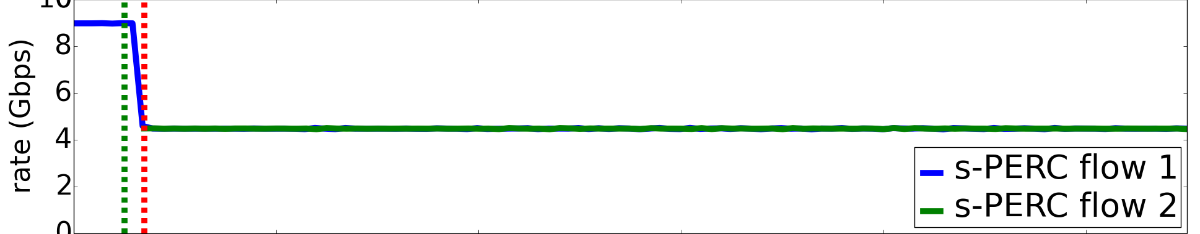
Why not ~1 round trip to find rates?
Proactive Explicit Rate Control
(PERC algorithm)
10
8
6
4
2
0
rate (Gb/s)
0 100 200 300 400 500
time (RTTs)
10 Gb/s links
0.2 ms RTT
Notes:
This is TCP in a simple experiment. Two servers send a flow to a third server, and the bottleneck link is 10 Gb/s. Here I am plotting the rate of the two flwos over time. TCP takes 400 RTTs to reach their fair shares.
You might think recent algorithms are better. Here’s DCTCP, it doesn’t do much better either, taking 250 RTTs.
Today, I’m going to show you something like this.

Slide 6
Flows can finish much faster
1MB / 100 Gb/s = 80 µs
= 7—8 RTTs
Notes:
Why do I care about the convergence speed in practice?
It turns out flows can finish much faster
Pie chart shows that more than half the flows, the red slice, are medium size. They are less than 1 MB and in a 100G network can finish in a few RTs, way less than the hundreds of RTS TCP takes to converge.

Slide 7
Most flows can finish long before congestion control finds good rates.
Notes:
What does this mean?
If we take a snapshot of the network, then the flow rates could be anywhere. What is clear is that nobody knows what our networks look like at any instant. What is the point of congestion control if we can’t find the rates fast enough? This the motivation for today’s talk.

Slide 8
Why “Reactive” Algorithms Are Slow
No info. about routing matrix, link speeds.
Measure congestion and adjust flow rates.
Timid steps to remain stable.
Adjust
Flow Rate
Measure Congestion
Notes:
Let’s take a step back and make sure we’re on the same page about reactive algorithms. Why are these “reactive” algorithms, that react to congestion signals, so slow?.
- they have no information about the routing matrix or link speeds
- so they must measure congestion and react to congestion signals like packet drops or queuing delays to adjust flow rates
- and they must take timid steps to remain stable
this speed v/s stability tradeoff that exists for any reactive algorithm, limits how fast that they can get to the target rate
In this talk, we look at a different approach. What if instead of reacting to congestion, we prevent it in the first place…

Slide 9
What if instead of reacting to congestion, we prevent it in the first place?

Slide 10
Proactive Algorithms
Use knowledge of the routing matrix and link speeds to calculate flow rates directly.
Centralized: can’t do this at scale
Distributed?
Notes:
One approach is to use knowledge of the routing matrix and link speeds to compute the rates directly. This is what recent work like Fastpass and FlowTune do, collect information about the set of flows in a central server, and compute the rates quickly and communicate theses to other servers. Directly calculating the rates can be very fast. (click) But we can’t do this at scale.
Can I do this in a distributed way?

Slide 11
PERC Algorithms
Red Flow’s Per-Link State | Link
 | 1 | 2
alloc. (a) | 10 | 1
“Proactive Explicit Rate Control (PERC)”
Link 1
10 G
Link 2
1 G
1
Notes:
What would such a distributed proactive algorithm look like?
Here’s a network with two links and one flow.
In a distributed proactive algorithm, there is a control packet for each flow, which carries the rate allocation from links on their path. It goes back and forth between the source and destination as long as the flow is active. Links (actually switches) update the packet with their estimate of the flow’s ideal rate.
Since the links proactively compute explicit rates for the flows, without even waiting for congestion to happen, we call
this Proactive Explicit Rate Control or PERC.

Slide 12
PERC algorithms for the Cloud
Practical algorithms should
update the control packet in a few nanoseconds
using very little switch memory, constant state.
Relevant today: cloud providers own entire infrastructure
Notes:
People have worked on PERC algorithms during the ATM era in the late 90s and early 2000s. And there are many PERC algorithms that are provably fast, none of these are practical to implement in the cloud. Today, we need practical algorithms that can update the control packet in a few nanoseconds, and using very little switch memory, preferably a constant amount of state .
PERC algorithms are relevant today because cloud providers own their entire infrastructure and can deploy something like this, which collects information about the whole network.
Add here? (If we had per-flow state, having each switch do local max-min rate calculations would lead to ..)

Slide 13
Max-Min Fairness
Link 1
10 G
Link 2
1 G
9
1
“Fair Share Rate”
C / N
= 10 G / 2
= 5 G
C / N
= 1 G / 1
= 1 G
Max-Min Rate
Notes:
For this talk, I focus on PERC algorithms for basic max-min fairness, though exploring practical PERC algorithms with known guarantees for other objectives is an open avenue for research.
Here is an example of a max-min fair allocation.
There are two links and two flows. The red flow gets a rate of 1 Gb/s because of Link 2, which leaves 9 Gb/s for the blue flow at Link 1.
An important definition to know is the fair share rate of a link, it is the capacity evenly divided among all flows sharing the link. In this example, the fair share rate at Link 1 is 5 Gb/s, and at Link 2 is 1 Gb/s. It turns out that if a link has the lowest fair share rate, then the rate is exactly its max-min rate.
So in this example, I am going to focus on the Link 2, and we’ll see how and why Link 2’s flow is allocated the fair share rate (at the link) in a bounded time.

Slide 14
Outline
Simple practical “naïve” PERC (n-PERC)
Can take arbitrarily long to converge
Modify n-PERC using constant state to get “stateless” PERC (s-PERC)
Converges in known bounded time
Without per-flow state at switches
Notes:
Before I describe practical PERC algorithms, let me give you a preview. I will start a simple algorithm, called n-PERC, for naïve PERC, to compute these rates. It turns out that the naïve PERC can take arbitrarily long to converge. Then I will describe our key insight--how to modify the algorithm using just a constant amount of state to get stateless PERC or s-PERC, which converges in a known bounded time, the first PERC algorithm to do so without per-flow state.

Slide 15
Two Kinds of Flows At a Link
B flow
Link 1
10 G
Link 2
1 G
9
1
E flow
(10 – 1) = 9 Gb/s
1
(C – SumE) = Max-Min Rate
NumB of B flow
Notes:
OK let’s dive in. Notice from this example, that a link can have two kinds of flows. From Link 1’s point of view, the blue flow is bottlenecked at the link, what we call a B flow for the link while the red flow is bottlenecked elsewhere, what we call an E flow for the link. Notice also that the max-min rate of the B flows is exactly
C – SumE* / NumB* where SumE is the rate allocated to E flows, and NumB is the number of B flows.
This suggests a simple way to estimate the rate of a bottlenecked flow using constant state at the link.

Slide 16
The n-PERC Algorithm
Calculate bottleneck rate assuming flow will be bottlenecked here, b = (C – SumE)/NumB
Calculate limit rate, e, lowest bottleneck rate elsewhere
Allocate lower of the two a = min(b,e)
Notes:
In n-PERC, each link maintains estimates SumE and NumB, to calculate a bottleneck rates. There are three steps. I’ll walk through an example later.
When a flow is seen at the link,
the link calculates a bottleneck rate b, assuming the flow is going to be bottlenecked
It calculates the limit rate e, as the lowest bottleneck rate the flow gets elsewhere. So the flow is limited to limit rate e by the rest of the network.
It then allocates the lower of the two values. This is the rate that the flow is allowed to send at based on where it appears to be bottlenecked.

Slide 17
The n-PERC Algorithm
Calculate bottleneck rate, b …
Calculate limit rate, e …
Allocate lower of the two ..
b = (1 – 0)/1 = 1 Gb/s
e = 10 Gb/s
a = min(b, e) = 1 Gb/s
Red Flow’s Per-Link State | Link
 | 1 | 2
bn. rate (b) | 10 | ∞
Link 2’s State
NumB | 1
SumE | 0
Link 1
10 G
Link 2’s State
NumB | 0
SumE | 0
Link 2
1 G
9
1
Notes:
Let’s walk through a quick example. This is the red flow’s control packet. Link 1 has filled in a bottleneck rate of 10 Gb/s and the packet is now at Link 2. Let’s walk through Link 2’s update.
It calculates a bottleneck rate of 1 Gb/s.
It calculates a limit rate of 10 Gb/s cuz of what Link 1 filled in.
It allocates the lower of the two.
Since the bottleneck rate is lower, the link estimates the flow is bottlenecked at the link and
updates the packet and link state to reflect this.

Slide 18
The n-PERC Algorithm
b = (1 – 0)/1 = 1 Gb/s
e = 10 Gb/s
a = min(b, e) = 1 Gb/s
b < e: bottlenecked here.
Calculate bottleneck rate, b …
Calculate limit rate, e …
Allocate lower of the two ..
Update packet and link
Red Flow’s Per-Link State | Link
 | 1 | 2
bn. rate (b) | 10 | 1
state @ alloc. (a) | B @ 10 | B @ 1
Red Flow’s Per-Link State | Link
 | 1 | 2
bn. rate (b) | 10 | ∞
Link 1
10 G
Link 2’s State
NumB | 1
SumE | 0
Link 2
1 G
9
1
Notes:
Since the bottleneck rate is lower, the link estimates the flow is bottlenecked at the link and
updates the packet and link state to reflect this.

Slide 19
The n-PERC Algorithm
Red Flow’s Per-Link State | Link
 | 1 | 2
bn. rate (b) | 10 | 1
state @ alloc. (a) | B @ 10 | B @ 1
Red Flow’s Per-Link State | Link
 | 1 | 2
bn. rate (b) | 10 | 1
state @ alloc. (a) | B @ 10 | B @ 1
Red Flow’s Per-Link State | Link
 | 1 | 2
bn. rate (b) | 10 | 1
state @ alloc. (a) | E @ 1 | B @ 1
Link 1
10 G
Link 2’s State
NumB | 0
SumE | 0
Link 2
1 G
9
1
Notes:
The flow is allocated 1 Gb/s at Link 2. You can guess what happens next. The packet is seen at Link 1, which sees the flow is limited to 1 Gb/s elsewhere at Link 2 and allocates 1 Gb/s to the flow. Then the packet is seen at the source end host that starts sending at 1 Gb/s .
Let’s go back to Link 2, the link with the lowest fair share, and talk about why this simple algorithm may converge.
Highlight bottleneck rate as I speak

Slide 20
The n-PERC Algorithm
b = 1 Gb/s
e = 10 Gb/s
a = min(b, e) = 1 Gb/s
b = 1 Gb/s
e = 10 Gb/s
a = min(b, e) = 1 Gb/s
b < e: bottlenecked here.
Red Flow’s Per-Link State | Link
 | 1 | 2
bn. rate (b) | 10
state @ alloc. (a) | B @ 10
Red Flow’s Per-Link State | Link
 | 1 | 2
bn. rate (b) | 10
state @ alloc. (a) | B @ 10
Link 1
10 G
Link 2’s State
NumB | 1
SumE | 0
Link 2
1 G
9
1
Notes:
Notice that Link 2’s red flow always gets a higher bottleneck rate from Link 1, whether it is 10 Gb/s as in this example, or 5 Gb/s, if Link 1 had seen both flows. This allows Link 2 to see immediately (within a round trip) that the red flow is indeed limited to higher rates everywhere else and so must be bottlenecked here at Link 2.
But is this always the case? If a link has the lowest fair share, do its flows always get higher rates from other links?
This is not very obvious, and this took me some time to understand, the bottleneck rates from other links could drop below even the lowest fair share.

Slide 21
Propagating a Bad Bottleneck Rate
b = 1 Gb/s
e = 0.5 Gb/s
a = min(b, e) = 0.5 Gb/s
e < b: bottlenecked elsewhere at 0.5 Gb/s!?
Red Flow’s Per-Link State | Link
 | 1 | 2
bn. rate (b) | 0.5
Link 2’s State
NumB | 1
SumE | 0
Link 1
10 Gb/s
C/N: 5 Gb/s
Link 2
1 Gb/s
C/N: 1 Gb/s
Link 2’s State
NumB | 0
SumE | 0
9
1
Notes:
In this example, this would be something like Link 1 fills in a bottleneck rate of 0.5 Gb/s. This is bad because confuses Link 2 into thinking that the red flow is bottlenecked at Link 1, and this delays convergence. This is an edge case that happens in some routing matrices for some orderings of the control packets at the links, but it prevents us from bounding the convergence time.
I ran a few thousand random simulations of this basic algorithm, n-PERC, and saw a few examples , that took a long time to converge; this one took between 70—80 RTTs for a network with four bottleneck links.

Slide 22
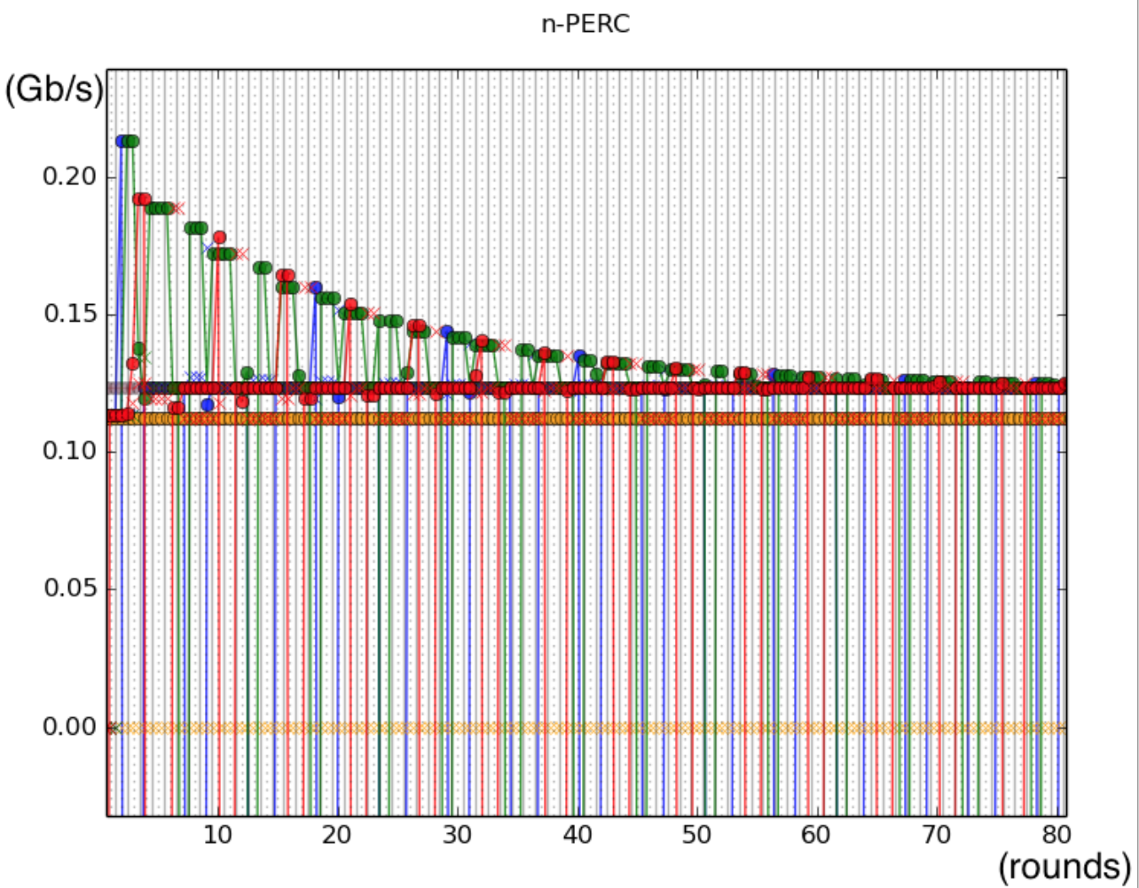
Bad bottleneck rates delay convergence
Notes:
I ran a few thousand random simulations of this basic algorithm, n-PERC, and saw a few examples , that took a long time to converge; this one took between 70—80 RTTs for a network with four bottleneck links.

Slide 23
Key Insight
Recognize when the bottleneck rate is safe to propagate, using constant state.
MaxE, maximum rate allocated to E flow in the last two RTTs.
Propagate b only when b >= MaxE.
Propagated rate at least fair share rate.
Link with lowest fair share recognizes B flows.
Notes:
Our key insight was every link, actually has enough information it sees over time, to recognize when the bottleneck rate is safe to proapgate, and it can do this using constant state. This allows us to bound the convergence time.
First, let me tell you how we avoid propagating bad rates. At each link, we track MaxE, the maximum E allocation for any flow in the last two RTTs, we propagate b only when it is at least MaxE, otherwise we ask other links to ignore the rate.
This ensures that when the propagate rate is at least the fair share rate, in other words, any rate propagated from Link 2 is at least 5 Gb/s. This allows the link with the lowest fair share to recognize its bottleneck flows.

Slide 24
The n-PERC Algorithm
The s-PERC Algorithm
Calculate bottleneck rate assuming flow will be bottlenecked here, b = (C – SumE)/NumB
Calculate limit rate, e, lowest bottleneck rate elsewhere
Allocate lower of the two a = min(b,e)
Update packet and link
Decide whether to propagate b (b >= MaxE?)
propagated
^
Notes:
That’s it!
The only modification the basic naïve algorithm is that at the end of the update, we decide whether it is safe to propagate the bottleneck rate
And the limit rate is the lowest ..
This is the complete s-PERC algorithm.
You can see that it’s pretty simple, and it does not need per-flow state at the links.

Slide 25
Link propagates at least its Fair Share Rate.
b= C-SumE NumB > C/N | B
 | E
 | E
 | E
propagate
b > MaxE.
MaxE < C/N
C/N
C/N
C/N
C/N
Notes:
Why is it true that the link always propagates at least its fair share rate? This is an even allocation of the link’s capacity. Let’s consider the case when b > MaxE and MaxE < C/N. This guarantees that all E allocations are less than C/N, which leaves at least C/N for the bottleneck flows.

Slide 26
Convergence of s-PERC
s-PERC converges in 6N RTTs, where N is the number of steps that k=2 Waterfilling takes for the same routing matrix and link speeds.
Notes:
Now some of you might be wondering, we only talked about Link 1’s bottleneck flow. What about Link 2’s bottleneck flow?
It turns out that if we can show that a PERC algorithm works for flows crossing a link with the lowest fair share rate, we can typically use a proof by induction to show that it works for the remaining flows too. You can check out our paper to learn about a class of centralized algorithms called k-Waterfilling, which help us to understand the precise order in which the remaining flows converge.
We show that s-PERC takes a 6N RTTs to converge to the max-min fair rates for all flows, where N is the number of iterations that 2-Waterfilling algorithm takes.
So now you have some idea of why s-PERC converges in a bounded time without per-flow state. Let’s look at how practical this algorithm.

Slide 27
s-PERC is practical 4x10 Gb/s NetFPGA SUME prototype
10
8
6
4
2
0
rate (Gb/s)
0 100 200 300 400 500
time (RTTs)
10 Gb/s links
0.2 ms RTT
Notes:
s-PERC is practical to implement in hardware at high speeds. We built a 40 Gb/s NetFPGA prototype, the measurements you saw in the beginning are from our test-bed. The rates converge to fair shares in a single RTT not hundreds of RTTs.

Slide 28
Fairness + Throughput for Long Flows, Low Latency for Short Flows
Convergence Times (Fairness)
10x faster than RCP in DC networks
1.3-6x faster than RCP in WAN networks
Flow Completion Times (Throughput for Long Flows, Latency for Short Flows)
Close to Ideal Max-Min For Long Flows
Close to Minimum For Short Flows
Notes:
What would cloud providers think of s-PERC? They want high throughput and fairness for long flows and low latency for short flows.
To understand how fair s-PERC is in practice, We compared convergence times of s-PERC and RCP, a fast reactive algorithm using packet simulations. Remember, faster convergence means that more flows are likely to get max-min rates during their lifetimes. We found that s-PERC converges 10 times faster in DC and 1.3—6 times faster in WAN.
We also looked at the flow completion times or FCT in datacenter workloads, for search and data mining/ the FCT captures throughput for long flows and latency for short flows. The FCT for long flows closely tracks the FCT that an ideal instant max-min allocator yields, while the FCT for short flows is close to minimum.
You can check out our paper for different aspects of a practical implementation of s-PERC: how we handle really short flows? how we mange control packet overhead? how we handle lost control packets etc.?

Slide 29
Conclusion
Reactive algorithms converge slowly relative to flow durations in fast networks.
Proactive PERC algorithms, use information about the network and flows to compute rates directly, they are much faster.
PERC algorithms are promising and relevant today and s-PERC, a distributed PERC algorithm for max-min fair rates without per-flow state, is only a first step.
Notes:
Today we have a problem with reactive algorithms for the cloud. Reactive algorithms converge slowly relative to flow durations.
Proactive PERC algorithms, use information about the network and flows to compute rates directly, they are much faster.
I hope I have convinced you that practical PERC algorithms are promising and relevant today; s-PERC, a distributed PERC algorithm that computes max-min fair rates in a known bounded time without per-flow state, is only the first step.
There is a lot of room for innovation, from developing practical PERC algorithms for different objectives to even optimizing s-PERC further to (and more?).

Slide 30
Thank you!

Slide 31
The bottleneck rate propagated by a link is at least its Fair Share Rate.
b= C-SumE NumB > C/N | B
 | E
 | E
 | E
b= C-SumE NumB > C/N | B
 | E
 | E
 | E
propagate
b > MaxE.
MaxE < C/N
C’/N’
C’/N’
C’/N’
C/N
C/N
C/N
C/N
Notes:
FAQ
(Why not just propagate infty? Once the link converges to the right rate, it should propagate it so other links can account for its flows currently.
Why not propagate C/N explicitly? Doing this implicitly, allows us to show that once the link with the lowest fair share converges, the same analysis applies to the remaining links and flows, after we ignore the rates of flows that have converged.)

Slide 32
Convergence Time (DC, 100G)

Slide 33
Convergence Times (WAN, 10G)

Slide 34
Convergence Times (PERC, worst-case)

Slide 35
Convergence Times (PERC, common)

Slide 36
k-Waterfilling: Recursive Algorithms To Compute Max-Min Rates
Link 1
Link 2
C = 1 Gb/s
N = 1
C/N = 1 Gb/s
C = 10 Gb/s
N = 2
C/N= 5 Gb/s
C = 1 Gb/s
N = 1
C/N = 1 Gb/s
C = 9 Gb/s
N = 1
C/N= 9 Gb/s
9
1
Fair Share Rate C/N
k = 2
k=1
Neighbors
1
2

Slide 37
k-Waterfilling (k=1, 2)

Slide 38
FCT (DC, 100G, search, 60%)

Slide 39
FCT (DC, data-mining, 60%)

Slide 40
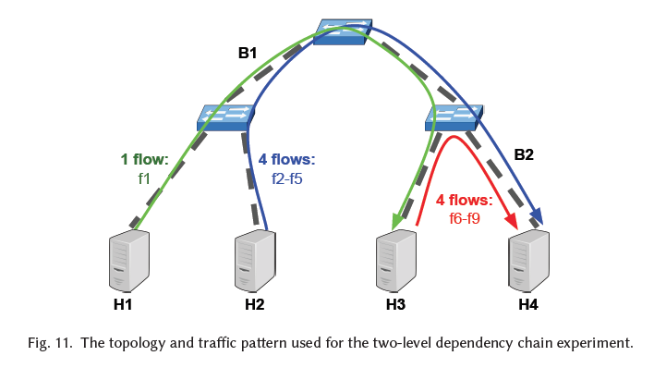
Testbed, 2-level experiment

Slide 41
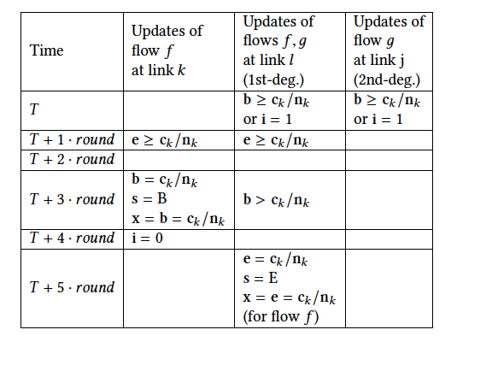
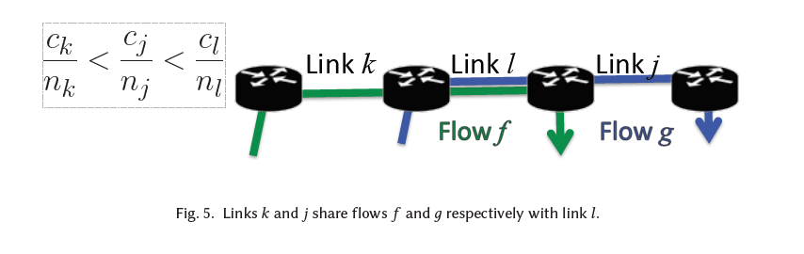
Why 6 RTTs per level?

Slide 42
Maintaining MaxE with constant state.
Timeout every RTT (e.g., 10⁵ cycles)
Initially,
MaxE’ = 0 (“maximum E alloc. in this RTT”)
MaxE = 0 (“maximum E alloc. in last two RTTs”)
On timeout:
MaxE reset to MaxE’ (so it doesn’t increase forever)
MaxE’ reset to 0 (reflects max. E since last timeout)

